Slide 1
BFX AT-100 RMA TOP 2 Issue:
eMMC Failure FA Report
Model Name BFX AT-100
Quantity | 1728pcs
Date | 11/04/2024
MO | 2645000324
Prepare by: PE – Luc
Date: 2024/06/11

Slide 2
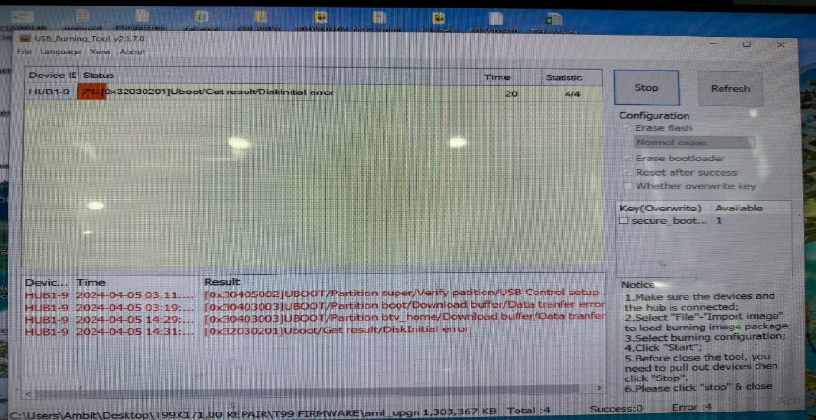
#1. Problem Description
Issue Description (5W2H) |  | Root Cause | Action | Owner | Status
When | 2024/April | Fail status: Download Factory FW stop 7%. Root cause: This issue follow material: Emmc-U602 P/N: 067.00140.005, Vendor: SAMSUNG. | Repair action: Change new Emmc <U602> can cover issue. Improve action: - Send FA report and NG material to vendor SAMSUNG for future analyzing. Done: 15/04 Material name: U602-eMMC P/N: 067.00140.005, Vendor: SAMSUNG. - SQE confirm with vendor Samsung will respond to failure analysis reports. Done: 29/05 | -PE: Luc/SQE: Naomi -Vendor: Samsung | Close
Who | ALT customer
Where | SK networks warehouse, Anseong, Korea.
What | ALT customer feedback that they found out 63/1728pcs pcs RMA has boot up fail.
Why | Product boot up fail and can't download Factory FW stop 7%
How much /many | UK 63/1728 = 3.65%~36458DDM
How Often | - This issue follow eMMC U602 (P/N: 067.00140.005, Vendor: SAMSUNG) material fail.
Download FW Stop 7%
2/N

Slide 3
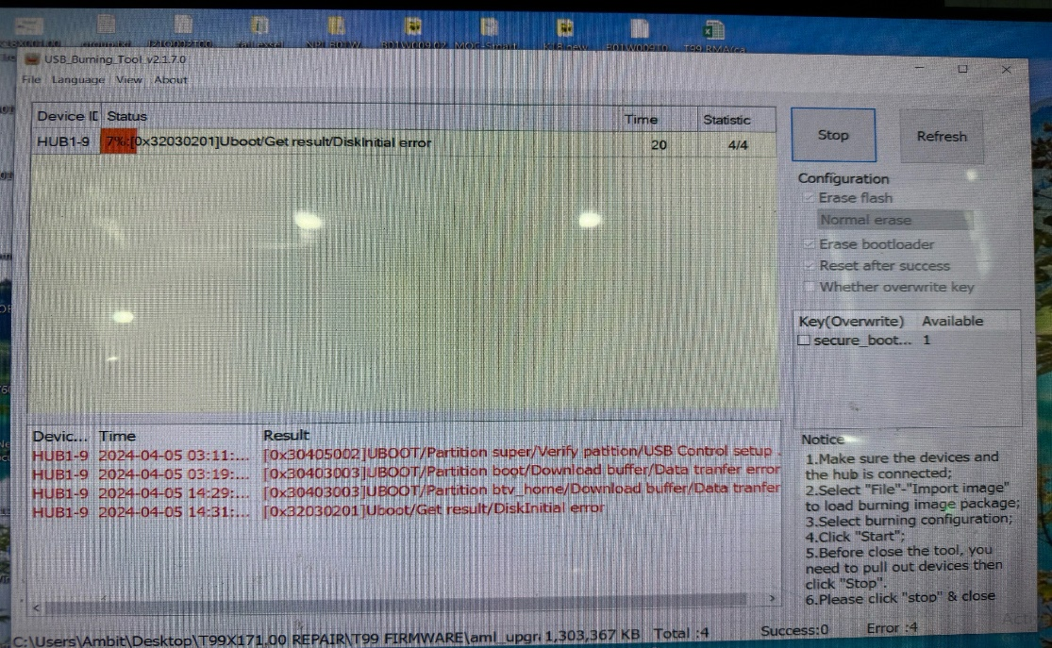
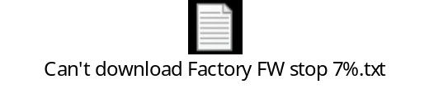

#2. Background Information
T99X171.00 with fail: Product boot up fail
Defect rate: 63/1728pcs = 36458 DPPM
Download Factory FW
Console UK FAIL 7%
Console UK PASS
Can't download Factory FW stop 7%
Console UK
Summary:
- Summary: The NG board boot up fail when download Factory Firmware stop 7%
Notes:
5.26891E-07 4.96855E-07

Slide 4
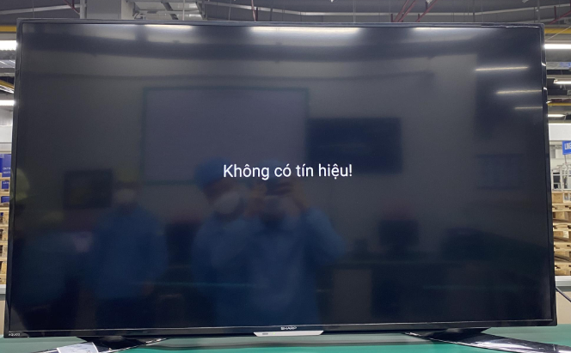
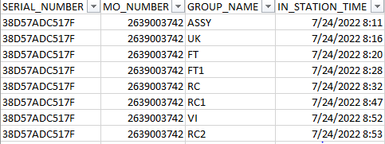
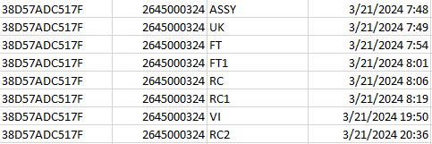
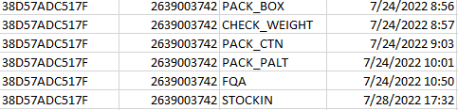

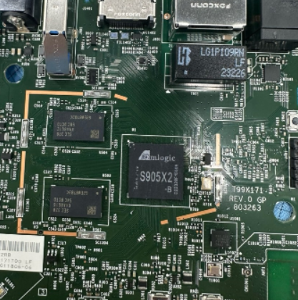
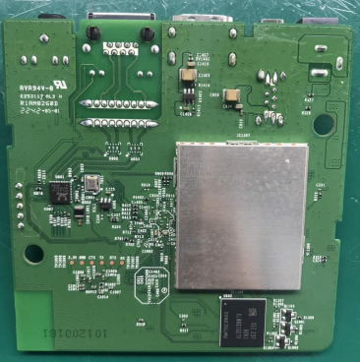
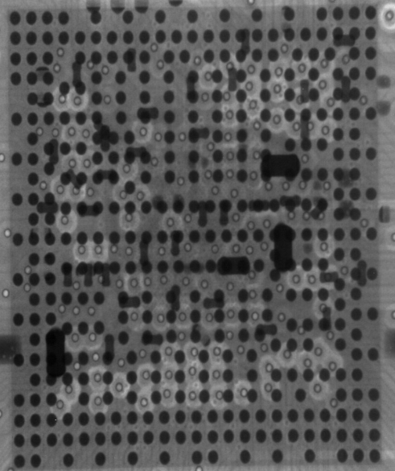
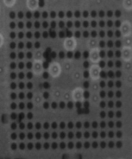
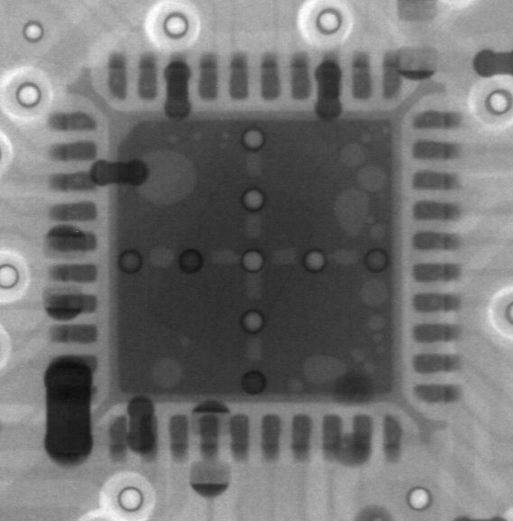
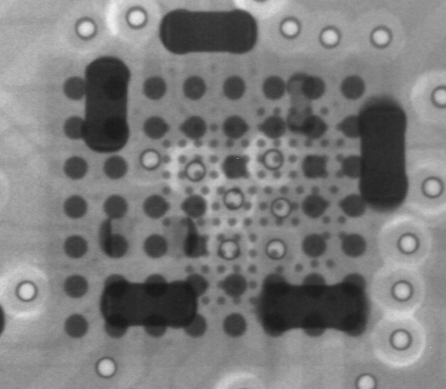
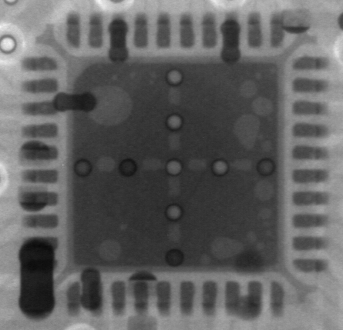
#3. System level
Board level
No# | Item check | Image reference | Result | Remark
1 | Recheck Boot up at OBA station |  | Fail | NG units boot up fail
2 | Recheck production data |  | Normal | Both Dot level & T level are OK
3 | Visual inspection |  | Normal | No process effecting to failure
4 | X-Ray focus on SoC, U801, U1101, U1001, eMMC location |  | Normal
Boot Up Fail
SoC
eMMC
U1101
U1001
U801
Summary: - Recheck Boot up 2/2pcs NG → Boot up fail
- Recheck production data, VI, X-ray are OK
"Listens to customers, Meet customer expectation"

Slide 5
#4. Failure Analysis NG1 + NG2 + NG3 Units
Component level -1
Measure impedance and VF NG1 + NG2 +NG3 units, received result as table below:
Measure impedance & VF voltage NG1 + NG2 Units
Location | Description | NG1 sample |  | NG2 sample |  | NG3 sample |  | OK sample
 |  | Impedance | VF | Impedance | VF | Impedance | VF | Impedance | VF
R328 | PP_PWR_IN | 3.33K | 0.503 | 3.313K | 0.506 | 3.046k | 0.5 | 3.260K | 0.504
L303 | P1V2 | 169.5 | 0.084 | 169.9 | 0.084 | 191.1 | 0.092 | 182 | 0.089
R325 | P2V5 | 21.37K | 0.390 | 21.69K | 0.393 | 18.45K | 0.363 | 21.61K | 0.392
L304 | P3V3 | 2.723k | 0.33 | 2.741K | 0.346 | 19.59K | 0.348 | 19.59K | 0.348
C322 | eMMC_VDDQ | 22.53k | 0.432 | 23.25K | 0.41 | 23.14K | 0.416 | 23.14K | 0.416
L301 | VDDCPU | 61.9 | 0.071 | 56.3 | 0.061 | 88.7 | 0.085 | 66.1 | 0.075
L302 | VDD_EE | 16.3 | 0.015 | 21.2 | 0.020 | 25.2 | 0.023 | 35.5 | 0.037
L801 | ETH_DVDD10 | 1.823k | 0.311 | 1.821K | 0.294 | 1.952K | 0.287 | 1.952K | 0.299
Summary:
- Measure impedance and VF NG1 + NG2 +NG3 units → No found out abnormal
"Listens to customers, Meet customer expectation"

Slide 6
#5. Failure Analysis NG1 + NG2 + NG3 Units
Component level -2
Measure impedance: Remove U1 and measure impedance result as table below:
NO# | Pin# | Description | NG 1 | NG 2 | NG 3 | OK Sample
 |  |  | Impedance | Impedance | Impedance | Impedance
1 | J32 | AVDD18_PCIe | 196.3M | 230K | 228K | 225K
2 | L29 | AVDD33_USB | 0.922M | 0.912M | 0.942M | 0.931M
3 | L31 | VDDIO_H | 30 | 32 | 27 | 38
4 | L33 | AVDD18_ENET | 1.495M | 1.62M | 1.495M | 1.525M
5 | L35 | AVDD18_USB | 1.321M | 1.345K | 1.345M | 1. 353M
6 | G14 | VDDQ | 1.7M | 1.94M | 58.7K | 32.3K
7 | G29 | VDDIO_AO | 40.1K | 42.2K | 40.6K | 37.3K
8 | N31 | AVDD18_AUDIO | 0.967M | 1.075M | 0.853M | 0.908M
9 | N33 | AVDD18_HDMI | 1.592M | 1.471M | 1.466M | 1.426M
10 | P13 | VDDQ | 11.25K | 11.12K | 10.82K | 10.11K
11 | P15 | VDDQ | 11.25K | 11.12K | 10.82K | 10.10K
12 | J14 | VDDQ | 11.28K | 11.85K | 9.88K | 10.26K
13 | J29 | VDDIO_C | 41.1 | 40.3 | 41.3 | 40.4
14 | R26 | AVDD0V8_USB_PCIe | 4.232K | 3.941K | 4.301K | 3.972K
15 | R28 | AVDD0V8_HDM | 28.56K | 28.87K | 29.54K | 28.84K
16 | R31 | AVDD18_AO | 1.252M | 1.17M | 1.076M | 1.14M
17 | R33 | AVDD18_CVBS | 1.413M | 1.42M | 1.323M | 1.379M
18 | AA23 | AVDD18_AO | 0.781M | 1.158M | 1.065M | 1.167M
19 | AG20 | VDDCPU | 44.4 | 42.8 | 50.2 | 48.5
20 | AG26 | VDD_EE | 11 | 29 | 29.9 | 27.2
21 | U15 | VDDQ | 58.5K | 56k | 74.2K | 69K
22 | U17 | VDD_EE | 11.1 | 28 | 29.6 | 25
23 | AC15 | AVDD_DDRPLL | 0.785M | 0.703M | 0.696M | 0.656M
24 | AJ15 | VDDQ | 11.72K | 11.09K | 10.76K | 10.49K
NO# | Pin# | Description | NG 1 | NG2 | NG3 | OK Sample
 |  |  | Impedance | Impedance | Impedance | Impedance
25 | U26 | VDD_EE | 34.2 | 34.7 | 34.9 | 31.5
39 | AJ20 | VDDCPU | 45.3 | 47.8 | 49.4 | 43.5
27 | AJ23 | VDDCPU | 45.3 | 47.6 | 49.5 | 43.5
28 | AJ26 | VDD_EE | 27.8 | 27.1 | 28.3 | 25.7
29 | AJ29 | VDD_EE | 28.8 | 28.4 | 28.9 | 26.2
30 | AJ31 | VDDAO_0V8 | 0.823M | 1.17K | 1.366K | 0.953K
31 | AJ39 | AVDD18_AO | 0.988M | 1.11M | 1.013M | 1.082M
32 | AE26 | VDD_EE | 10.9 | 29 | 29.2 | 26.7
33 | AL20 | VDDCPU | 45.1 | 47.9 | 50.3 | 44.7
34 | AL23 | VDDCPU | 45 | 48 | 50.2 | 44.8
35 | Y15 | VDDQ | 54.8K | 72.1K | 55.5K | 70.4K
36 | AF15 | VDDQ | 54.2K | 70.6K | 54.4K | 69.4K
37 | AF17 | VDD_EE | 27.7 | 27.7 | 28.4 | 25.9
38 | AF29 | VDD_EE | 10.9 | 27.7 | 28.4 | 25.8
39 | AF31 | VDD_EE | 10.7 | 27.5 | 28.3 | 25.8
40 | AM31 | VDD_EE | 26.8 | 13.3 | 37.8 | 40.7
41 | AU26 | VDDCPU | 48.6 | 49.4 | 50.3 | 44.7
42 | AV37 | VDDIO_X | 2.63M | 2.51M | 2.668M | 2.54M
43 | AV39 | VDDIO_Z | 3.41M | 3.45M | 3.520M | 3.47M
44 | AN23 | VDDCPU | 2.8M | 3.17M | 3.09M | 3.16M
45 | AW20 | VDDIO_BOOT | 3.540M | 3.18M | 3.108M | 3.03M
46 | AW26 | VDDCPU | 54.8 | 61 | 64.8 | 58.2
47 | AR26 | VDDCPU | 55.8 | 60.8 | 64.9 | 53.4
Summary: After measure impedance U1 no found out abnormal.
,
"Listens to customers, Meet customer expectation"

Slide 7
#6. Failure Analysis NG1 + NG2 + NG3 Units
Component level -3
Measure impedance: Remove U602 and measure impedance result as table below:
Pin# | Description | NG 1 | NG 2 | NG 3 | OK Sample
 |  | Impedance | Impedance | Impedance | Impedance
A3 | DAT0 | NA | NA | NA | NA
A4 | DAT1 | NA | NA | NA | NA
A5 | DAT2 | NA | NA | NA | NA
B2 | DAT3 | 1.635M | 1.607M | 1.522M | 1.433M
B3 | DAT4 | 18.74K | 17.80K | 16.31K | 25.78K
B4 | DAT5 | NA | NA | NA | NA
B5 | DAT6 | NA | NA | NA | NA
B6 | DAT7 | NA | NA | NA | NA
K5 | RSTN | 1.637M | 1.606M | 1.512M | 1.516M
C6 | VDD | NA | NA | NA | NA
M4 | VDD | NA | NA | NA | NA
N4 | VDD | NA | NA | NA | NA
P3 | VDD | NA | NA | NA | NA
P5 | VDD | NA | NA | NA | NA
E6 | VDDF | 2.339M | 2.326M | 2.327M | 2.266M
F5 | VDDF | 2.340M | 2.326M | 2.328M | 2.262M
J10 | VDDF | 2.335M | 2.224M | 2.294M | 2.261M
K9 | VDDF | 2.323M | 2.328M | 2.328M | 2.299M
C2 | VDDI | 1.615M | 1.608M | 1.521M | 1.460M
M5 | CMD | NA | NA | NA | NA
Pin# | Description | NG 1 | NG2 | NG3 | OK Sample
 |  | Impedance | Impedance | Impedance | Impedance
H5 | Data Strobe | NA | NA | NA | NA
M6 | CLK | NA | NA | NA | NA
J5 | VSS | NA | NA | NA | NA
A6 | VSS | NA | NA | NA | NA
C4 | VSS | NA | NA | NA | NA
E7 | VSS | 0.3 | 0.2 | 0.2 | 0.2
G5 | VSS | 0.2 | 0.42 | 0.3 | 0.2
H10 | VSS | 0.2 | 0.3 | 0.3 | 0.3
K8 | VSS | NA | NA | NA | NA
N2 | VSS | NA | NA | NA | NA
N5 | VSS | NA | NA | NA | NA
P4 | VSS | NA | NA | NA | NA
P6 | VSS | NA | NA | NA | NA
Summary: After measure impedance U602 no found out abnormal.
"Listens to customers, Meet customer expectation"

Slide 8
#5. Failure Analysis NG1 + NG2 + NG3 Units
Component level -4
Swap verification between OK and NG U602 material and retest all functions + OBA test, result as table below:
Swap verification | NG1 | NG2 | NG3
OK board + OK U602 | OK | OK | OK
NG board + NG U602 | NG | NG | NG
OK board + NG U602 | NG | NG | NG
NG board + OK U602 | OK | OK | OK
Summary: As analysis above this issue follow U602 (P/N: 002.02152.005) component.
"Listens to customers, Meet customer expectation"

Slide 9
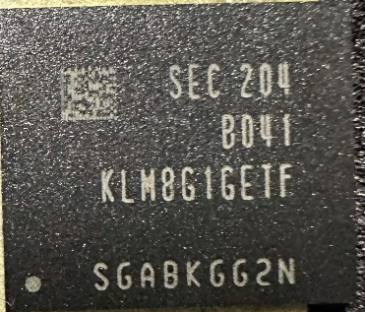
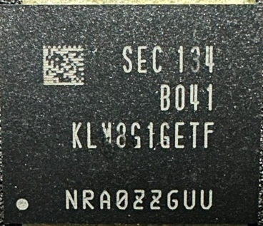
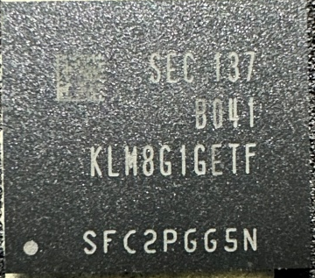
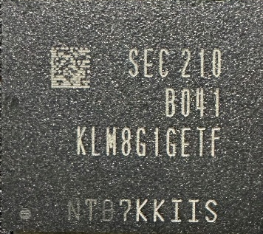

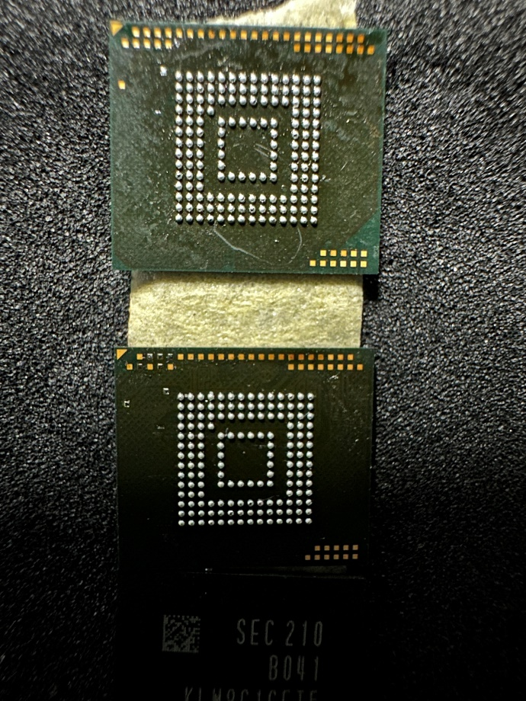
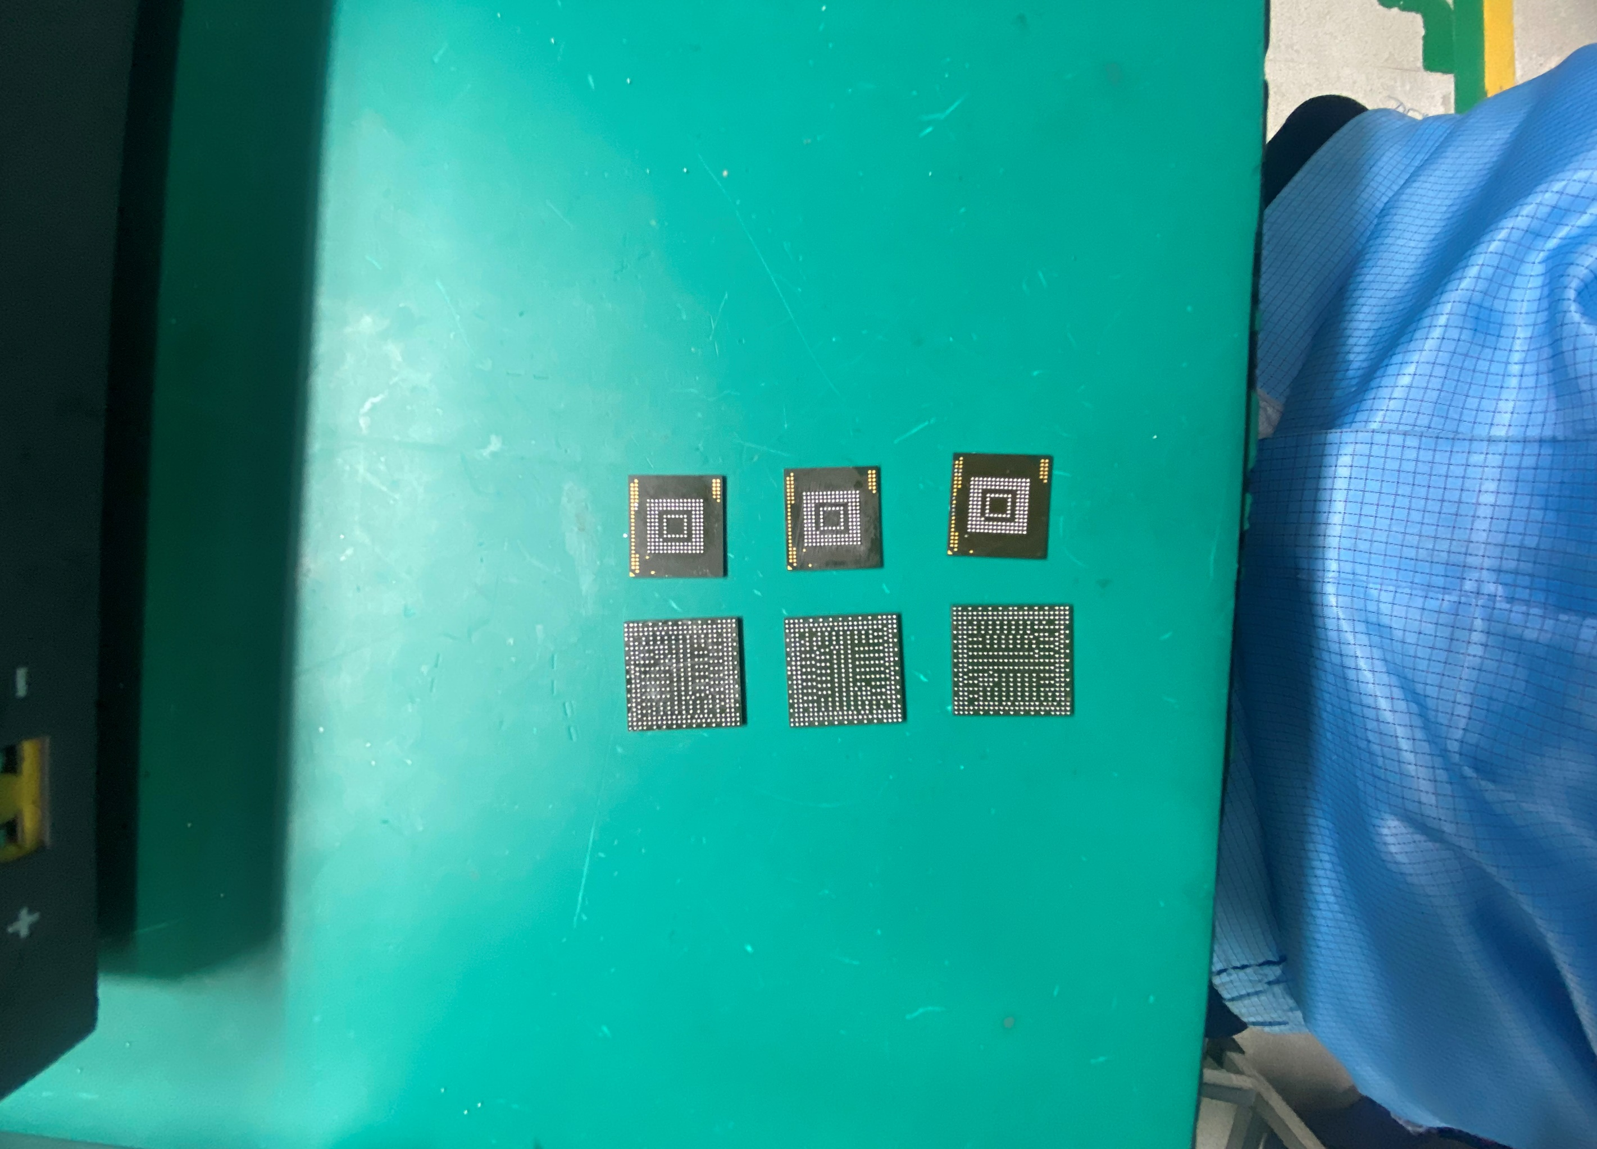

#7. IC U602 Information Shipping
Visual Inspection and sent 5pcs NG sample to SQE pictures as below:
NG.# | NG1 | NG2 | NG3 | NG4 | NG5
Date Code | SEC204 | SEC134 | SEC137 | SEC210 | SEC243
Top side
Bottom side
Summary:
- Summary: VI 5pcs NG sample will sent to SQE Don’t find out any abnormal..

Slide 10

#8. Conclusion
On 29/05 SamSung vendor feedback for this issue.
Based on the test customer’s results, we think the failed units were caused by unexpected environment which is sudden power off, unstable power supply etc…→ is the causes FW corruption and leads to errors such as Meta corruption and UECC (uncorrectable ECC error) in Emmc
This is attached: →
Action:
Customers use of power stabilizers, power filters, separate power supply installation, regular maintenance, lightning protection devices, electrical system design, electrical system design according to standards and FW/Software testing periodic hardness.
→ These solution will help increase power supply stability, minimize the rick of eMMC damage, and improve EMMC burning FW fail.

